Slide 1
BUilding in a Day: Comparing Structure from Motion Across Scenes
Noah Markowitz and Kanghyun Lee
CS585 Spring 2024

Slide 2
Editing this Template
Camera Calibration
Data Collection (Taking Photos Ourselves!)
Feature Detection
Feature Matching
Creating Tracks
Bundle Adjustment
Undistorting Images
Computing Depthmaps
Dense Pointcloud Reconstruction

Slide 3
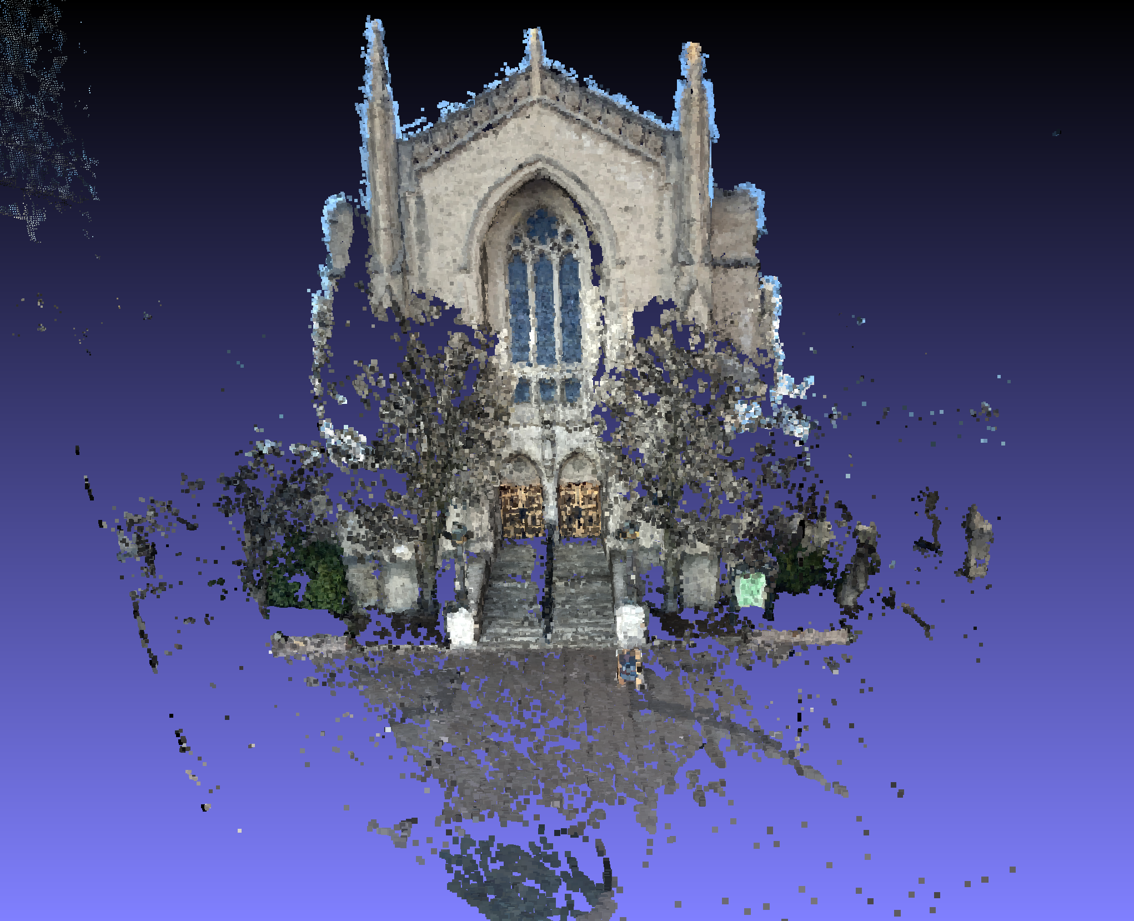
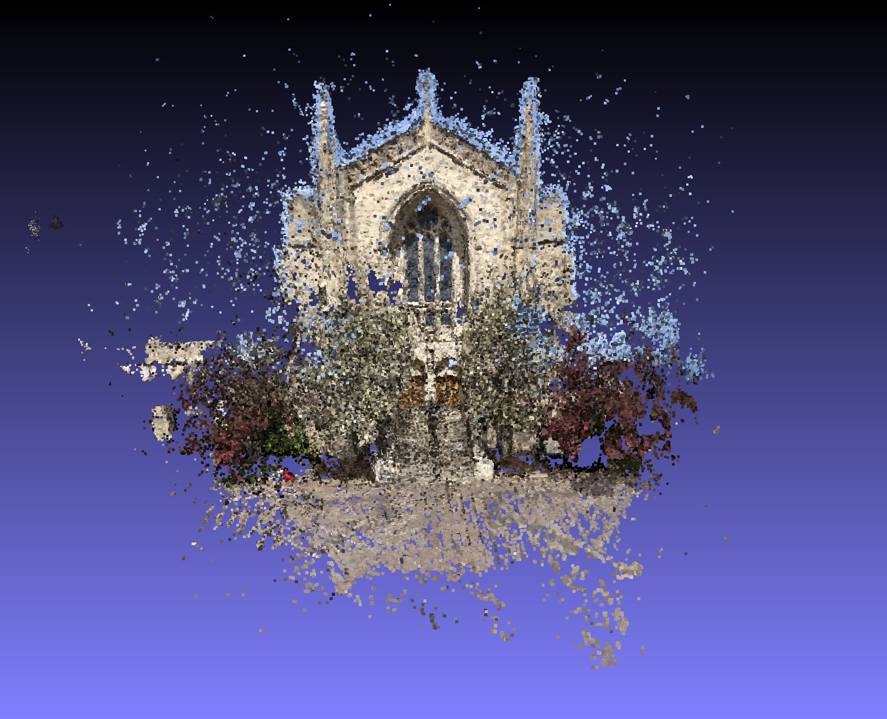
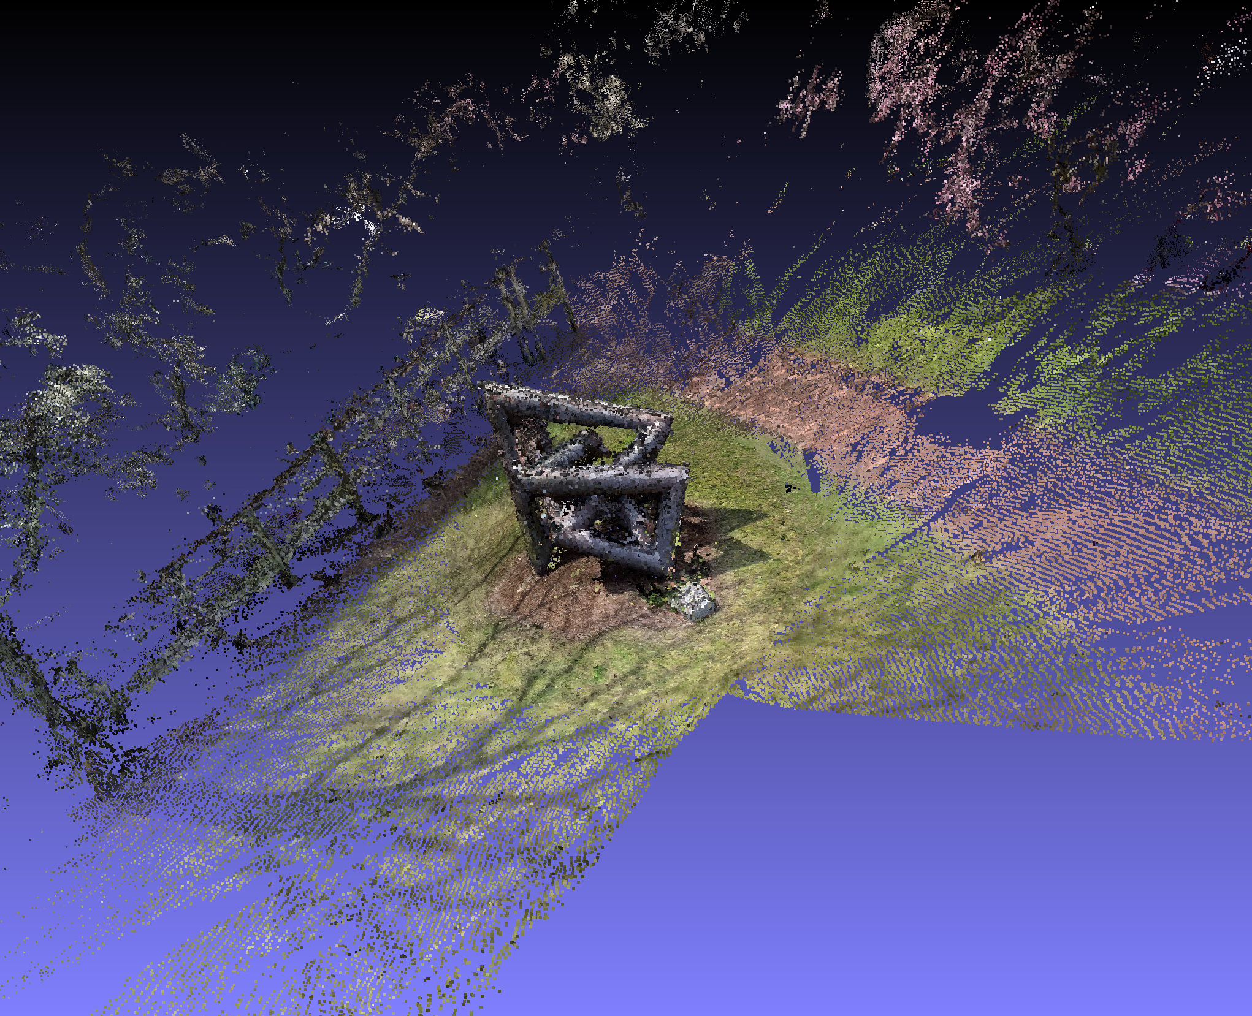
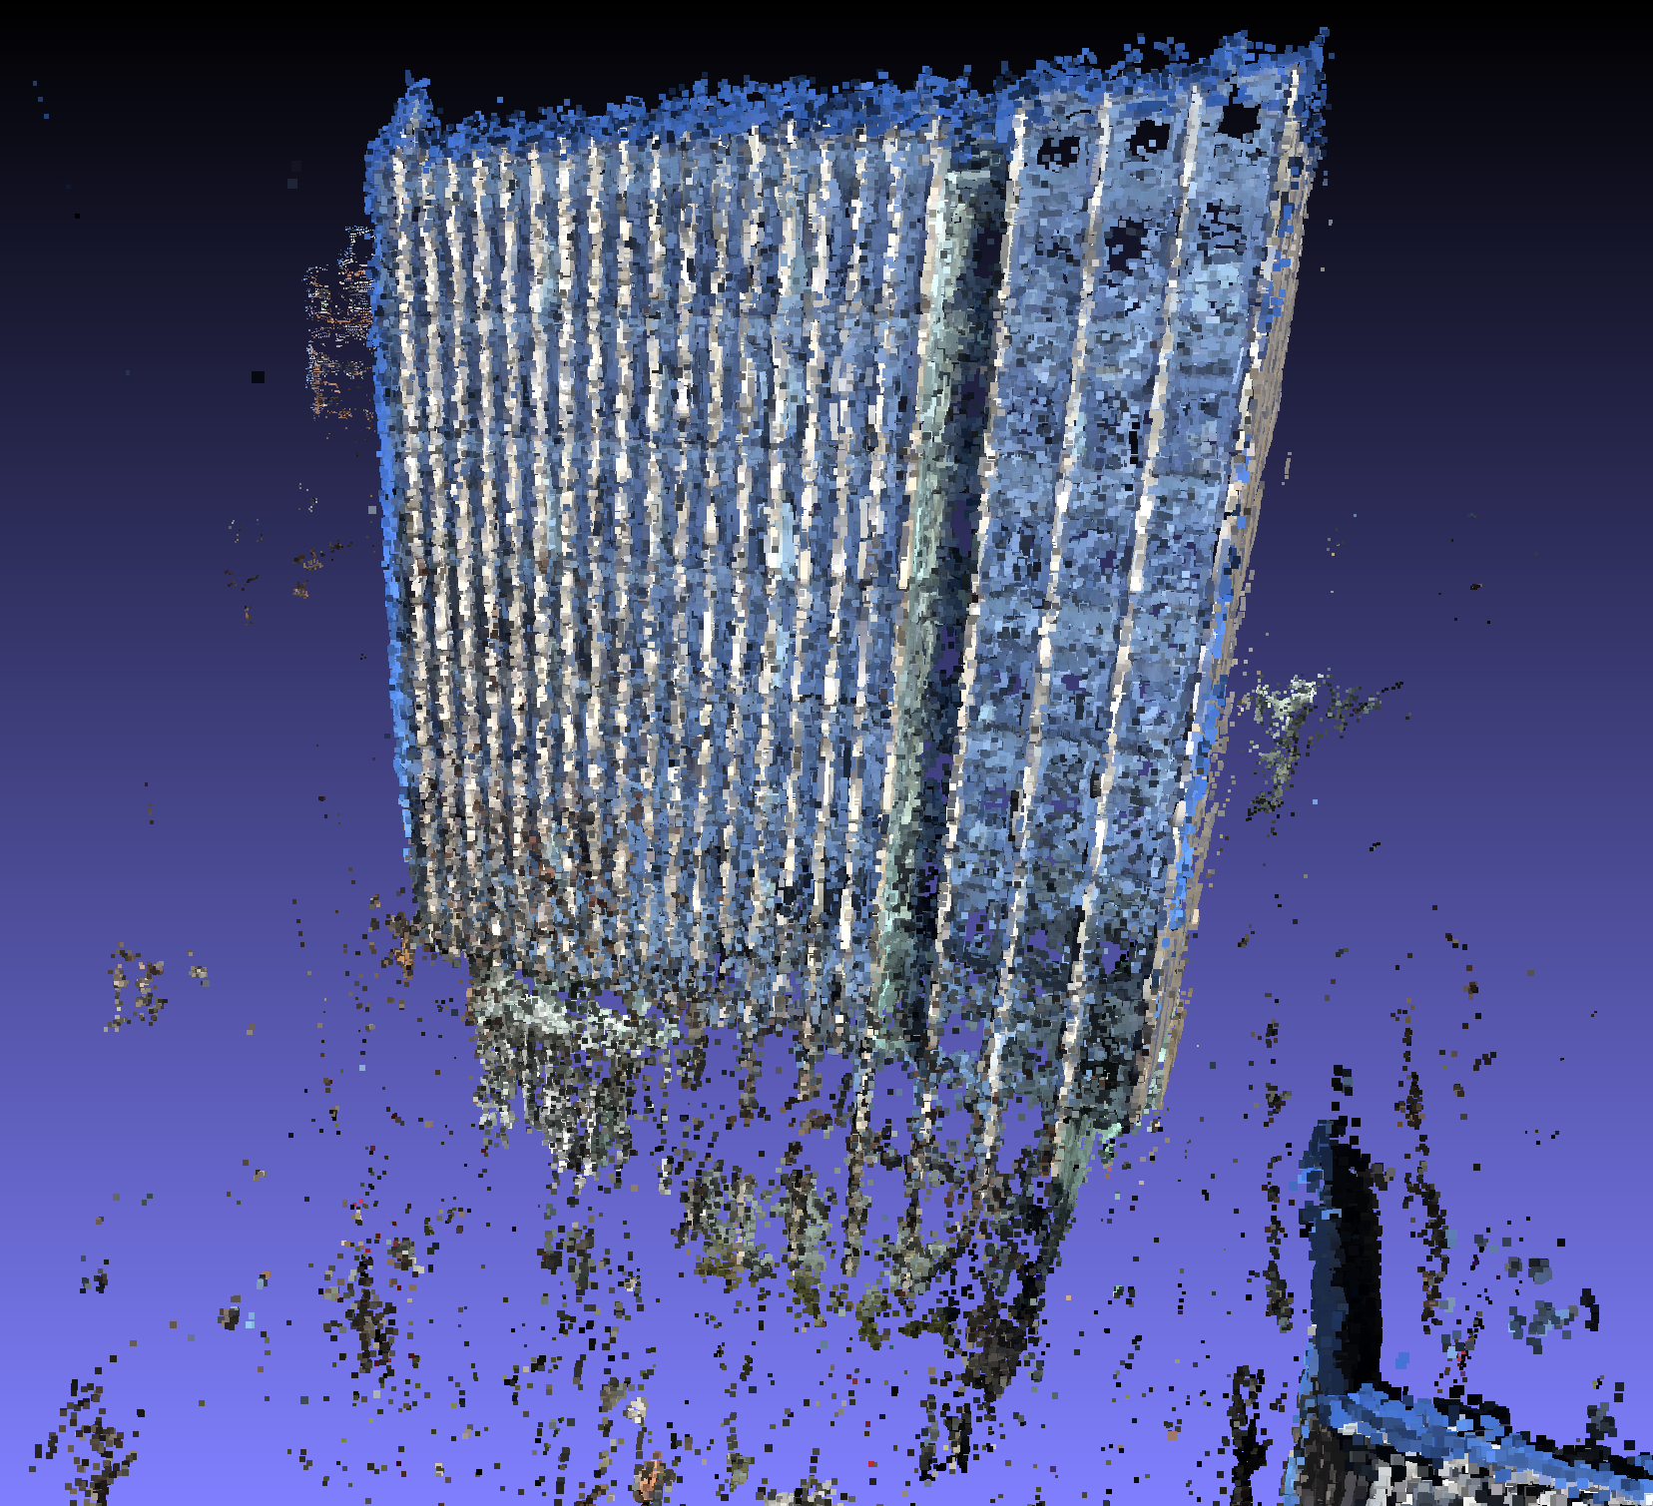
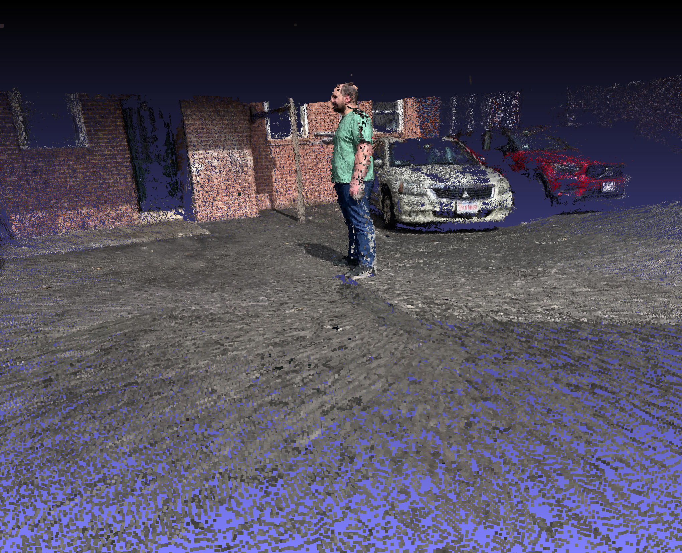
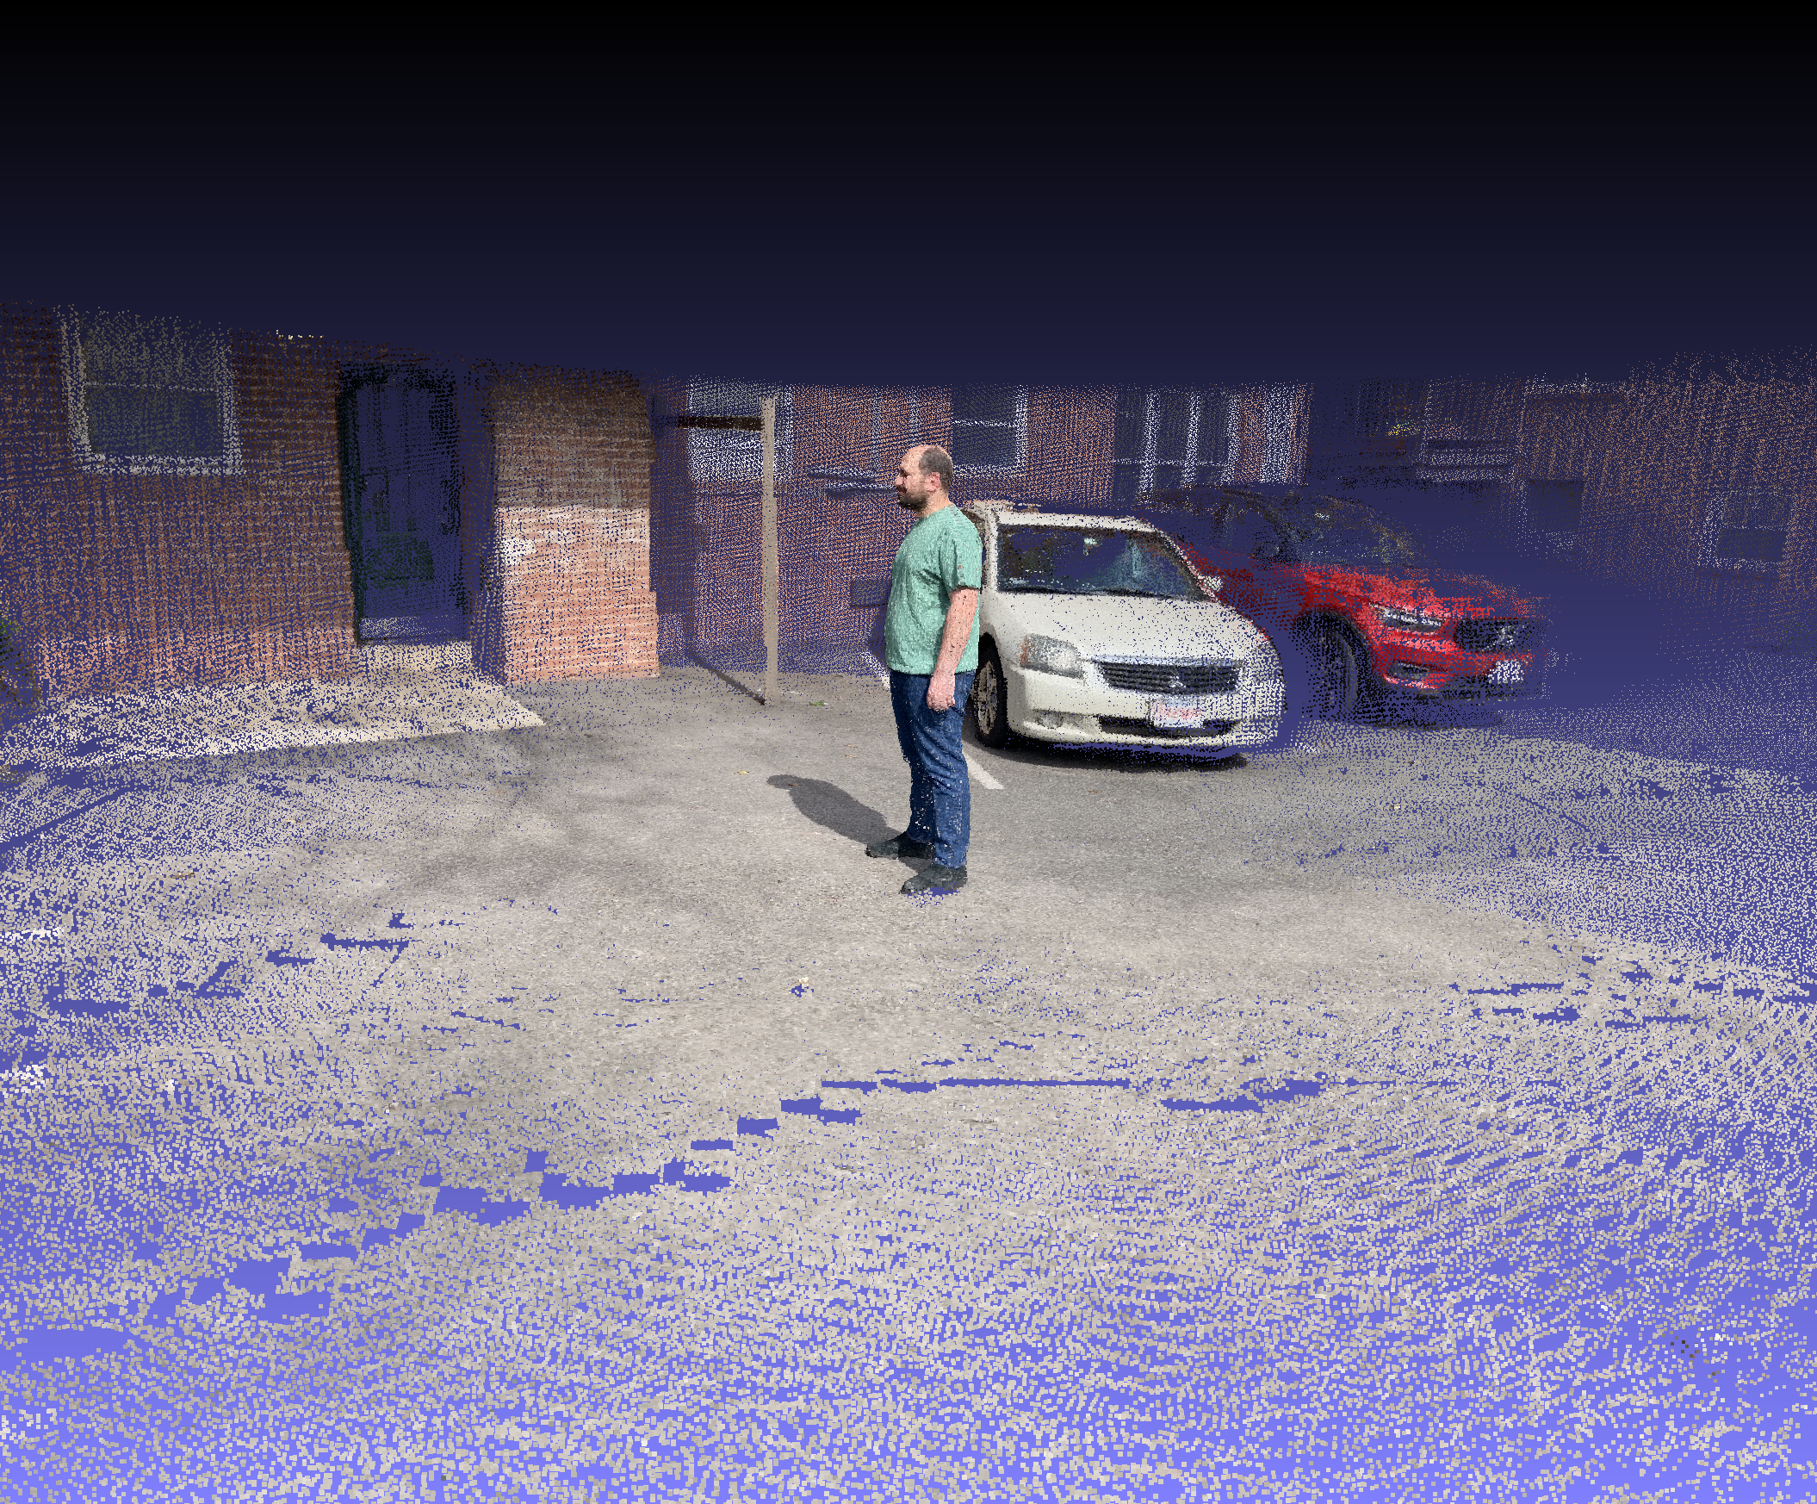
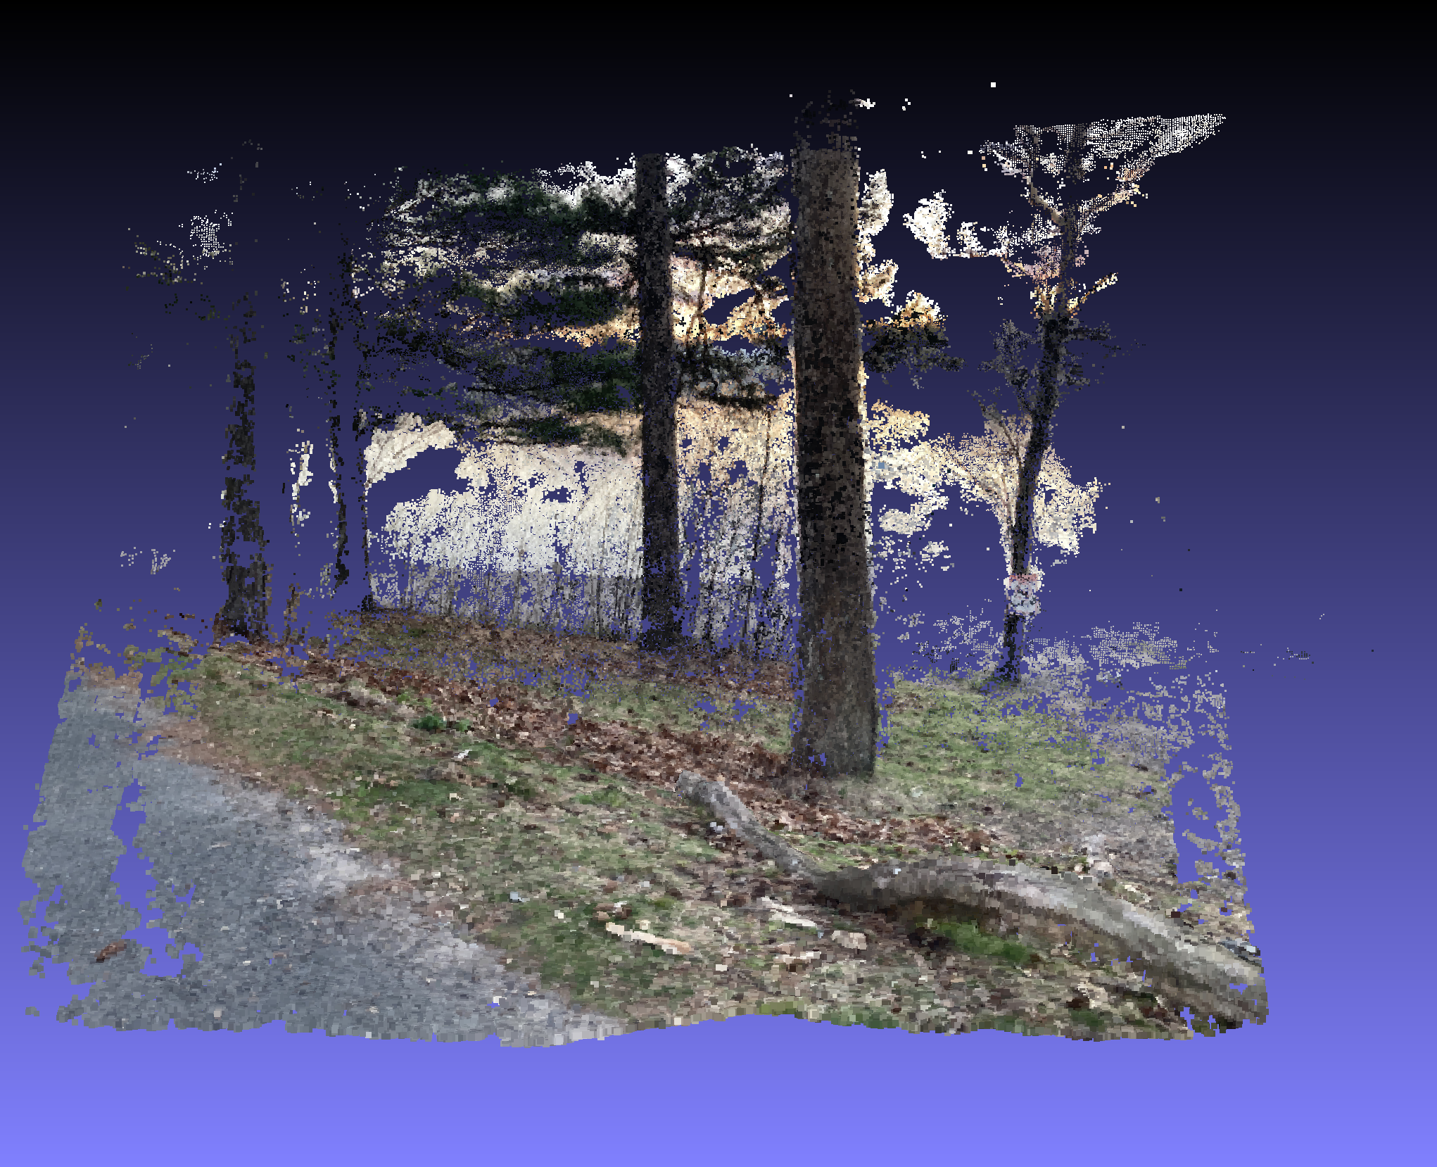
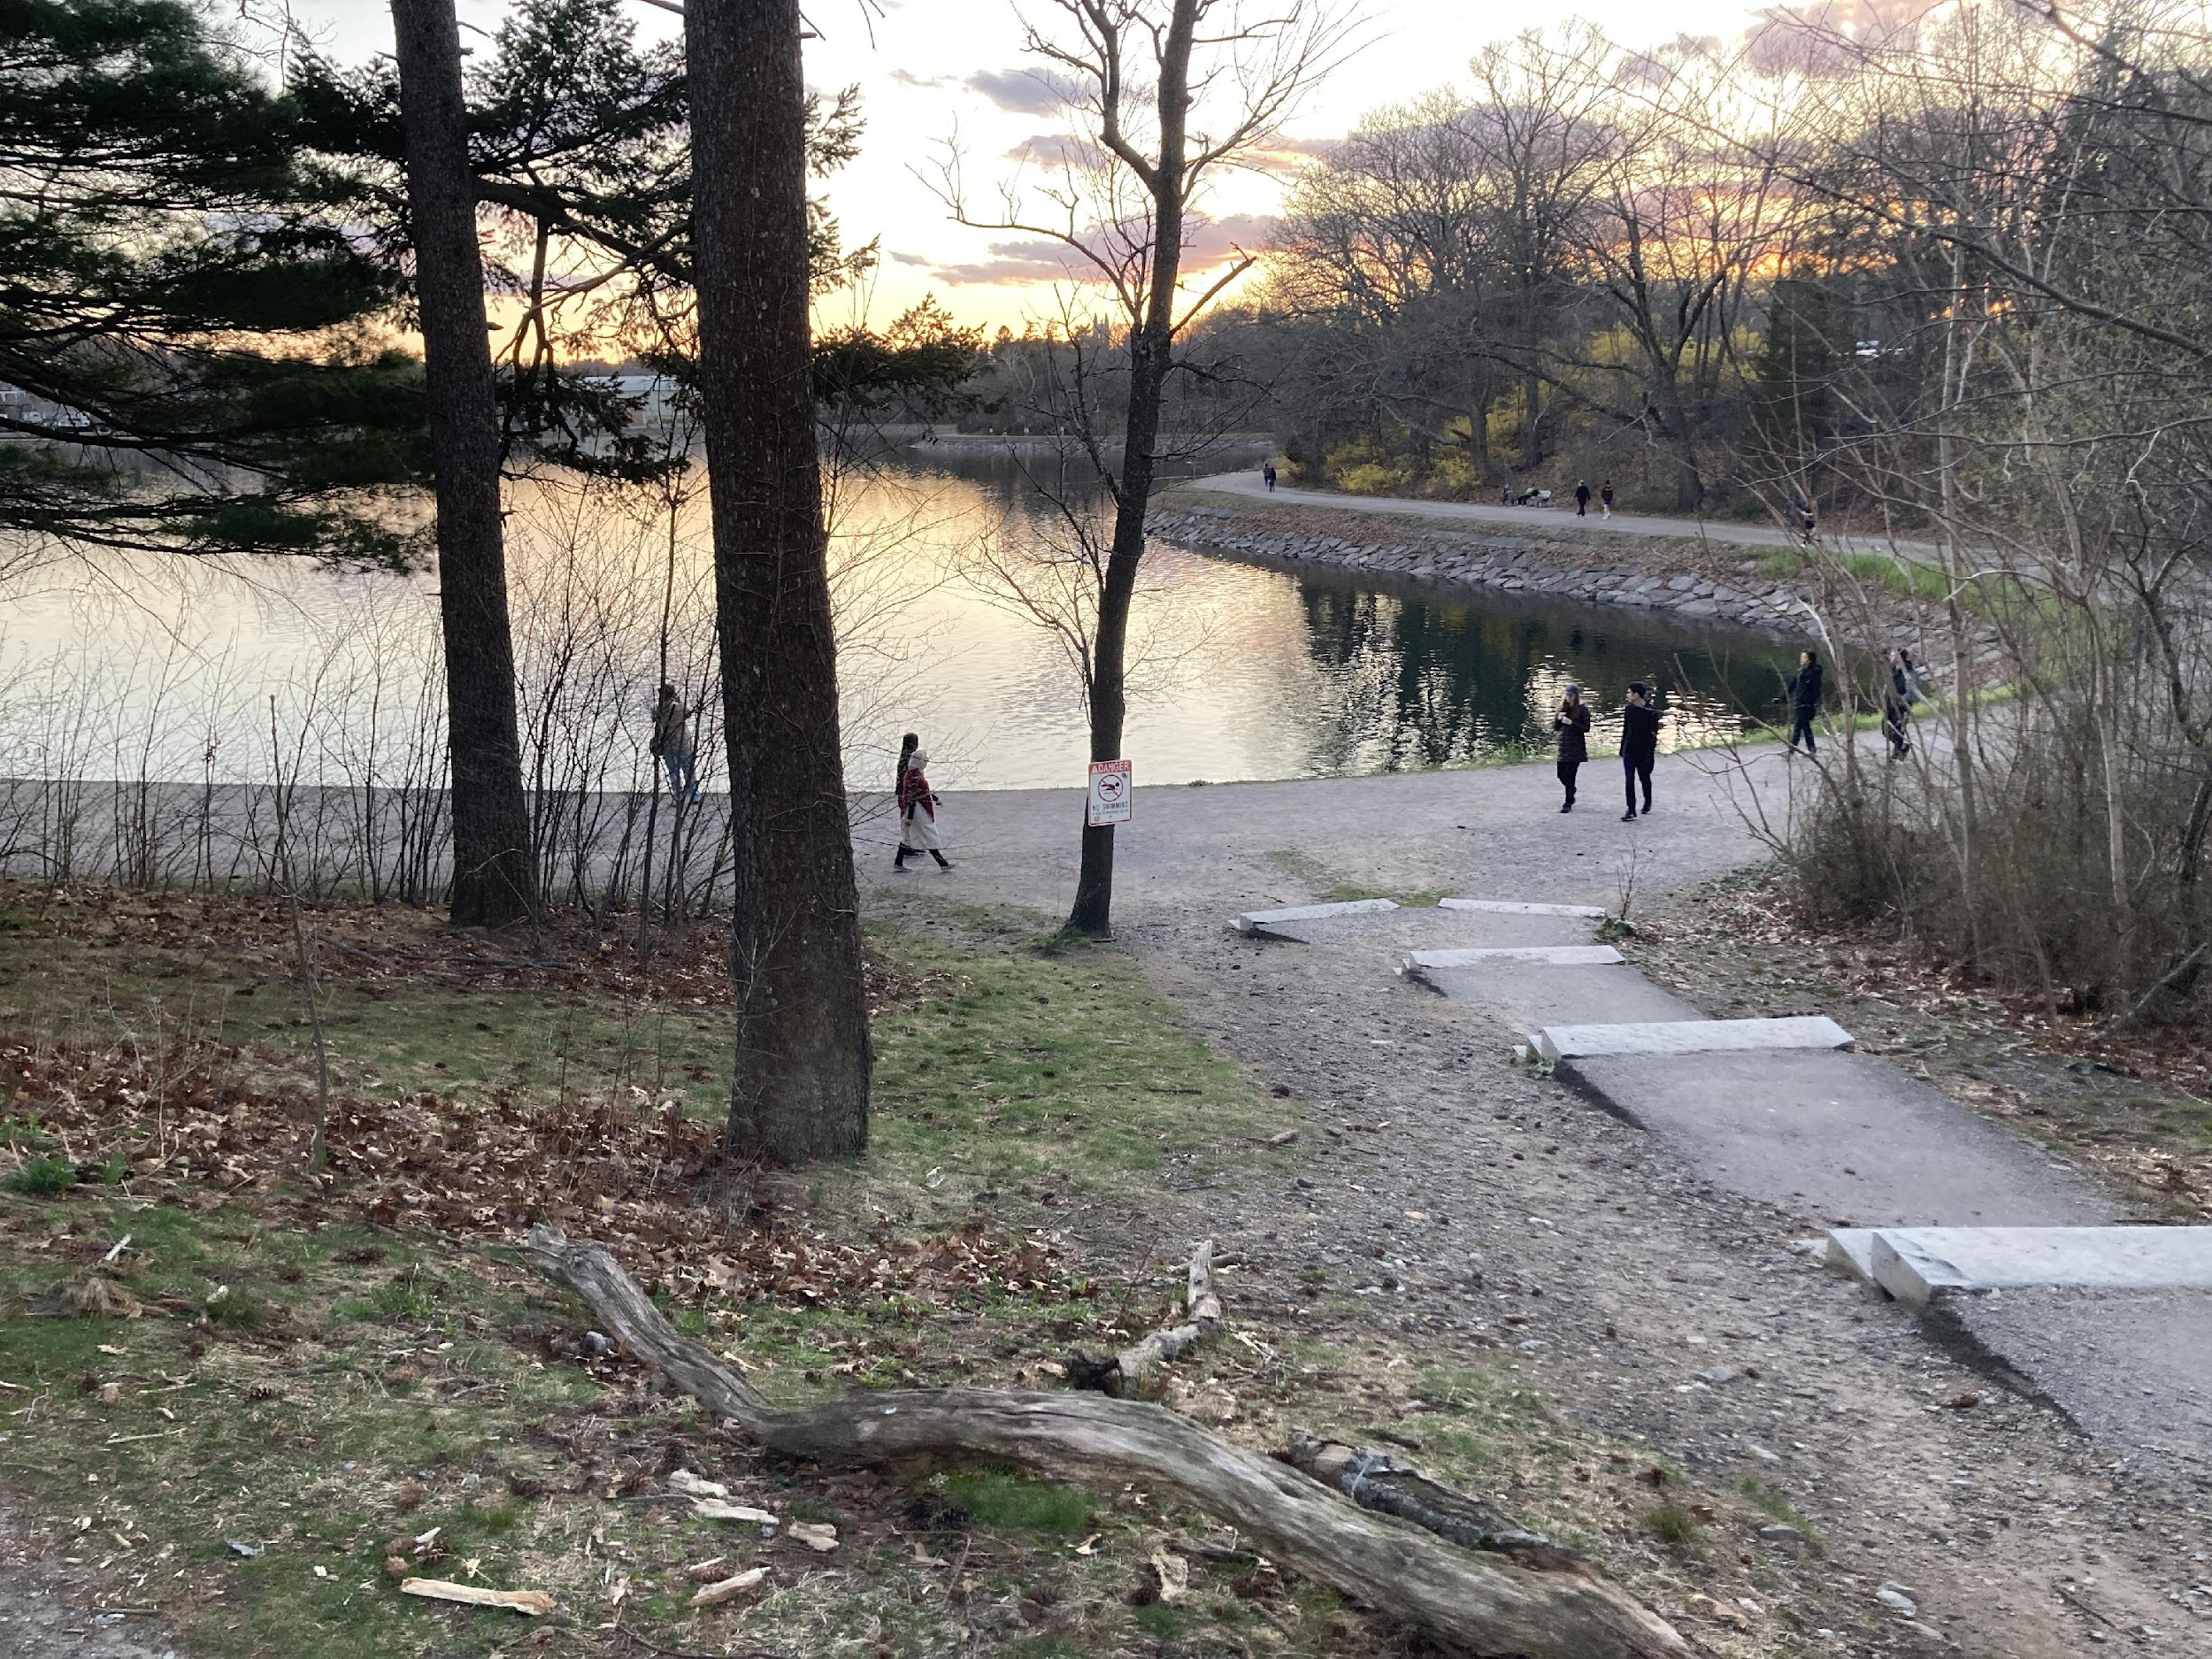
Results
Buildings
Geographic Scenery
Human (NeRFs)

Slide 4
Conclusions and Future Work
Conclusions
SfM great for: Large Structures, Sparse Image Availability
SfM limits: Smaller size structures noisy
Future Work
Multiperspective Aerial Photography of landscapes and cityscapes

